Slide 1

Information Systems Group QCC team
7 Dragon Balls
QCC Story

Slide 2



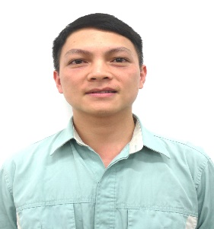

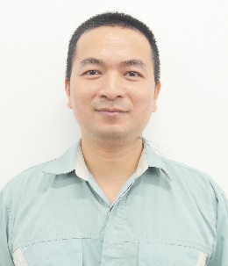
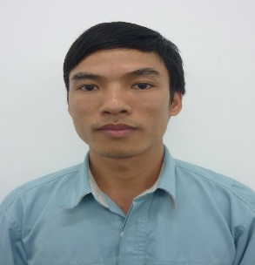


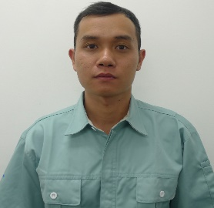
Team Introduction
1/18
LEADER
Advisor
Supporter
7 Dragon balls
Team
Develop
Infra team
Stationery team
Engineering
1
7 Member
Infra team
2
04 Sections
Slogan
3
Register: 01.Oct.2023
Change Mindset !
4
Finish: 28-Feb-2024
5
Total: 4 Months

Slide 3








Team Introduction
2/18
Team Skills
Meeting attendance
Join
98%
Average
2.8
1 Time/ Week
Evaluation criteria
16 Week
Low
Normal
Fair
Good
Excellent
1.5 Hour meeting
1
2
3
4
5
3.8
Average Skill: 2.8
Let’s Go
Average Target !

Slide 4


QCC Action Process
3/18
Quality the first
Step 8
FUTURE PLAN
Step 7
STANDRADIZATION
Step 6
Step 5
EFFECT
CONFIRM
Step 4
TAKE ACTION
Step 3
ANALYSE
CAUSE
Step 2
ACTION
PLAN
Step 1
TARGET
SETING
THEME SELECT

Slide 5

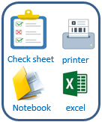

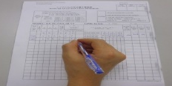
Theme Selection
4/18
Current Asset Management IT
Why ?
Good receipt
Use Excel manage equipment
Scrap
Transfer
To Inventory PC by Paper
How to save time to management equipment?
Inventory
Maintenance
 | Quantity | Time inventory / month (hours)
Stationery Item | 490 | 490
Infra Equipment | 652 | 652
Theme
Improve inventory IT asset procedure
Manual job, waste papers.
Take time to inventory.
Difficult control in-out.
Easy mistake.
Not ensure quality.

Slide 6

Setting Up Target
5/18
Standardization All Manual Operations
Save Time Inventory
Good receipt
Transfer
Maintenance
Inventory
Scrap
100%
Paper
80%
100%
Time
66,7%
20%
33,3%
ALCMS
Reduce paper: 80%
Save time inventory: 80%
Goal : Save time inventory, reduce manual job!

Slide 7





Action Plan
6/18
PDCA | No | What | Where | When |  |  |  |  |  |  |  |  |  |  |  |  |  |  |  |  |  |  |  | Who | How
 |  | Content | Location | Oct |  |  |  | Nov |  |  |  | Dec |  |  |  | Jan |  |  |  | Feb |  |  |  |  | Tool
 | 1 | Choosing theme | IT Training |  |  |  |  |  |  |  |  |  |  |  |  |  |  |  |  |  |  |  |  | Chung | Chart
 | 2 | Establishing target | QCC |  |  |  |  |  |  |  |  |  |  |  |  |  |  |  |  |  |  |  |  | Hien | Chart
 | 3 | Marking Action plan | QCC |  |  |  |  |  |  |  |  |  |  |  |  |  |  |  |  |  |  |  |  | Minh | Gant chart
 | 4 | Analyzing | IT Training |  |  |  |  |  |  |  |  |  |  |  |  |  |  |  |  |  |  |  |  | All member | Fishbone 5 why
 | 5 | Implement Countermeasure | IT Training |  |  |  |  |  |  |  |  |  |  |  |  |  |  |  |  |  |  |  |  | All member | PDCA
 | 6 | Confirming effect | QCC |  |  |  |  |  |  |  |  |  |  |  |  |  |  |  |  |  |  |  |  | Trinh, Hai | Chart
 | 7 | Standardization | QCC |  |  |  |  |  |  |  |  |  |  |  |  |  |  |  |  |  |  |  |  | Minh | WI/Document
 | 8 | Reviewing & next theme | IT Training |  |  |  |  |  |  |  |  |  |  |  |  |  |  |  |  |  |  |  |  | All member | Pareto chart
Remark:
Plan
Actual

Slide 8


Diagram Analysis
7/18
Fishbone Analysis
MACHINE
MATERIAL
Paper & check sheet
③
No software
No barcode equipment
Mobile device
Desktop PC
manual
Good signal
Print barcode
Manual checking
No identify
①
Win CE end of line 2023
Run faster
Handy terminal
Many equipment
Poor signal
Easy mistake
Run slowly
Difficult trace history
Save time inventory
Inattention
Not clear process
Wrong operate
Many steps
Not comply
Not follow
instruction
Record data
Non understand
Many Excel file
Knowledge
Manual job
Not visualize
Find & compare
Lack training
Inventory
MAN
②
Take time to make report
METHOD

Slide 9




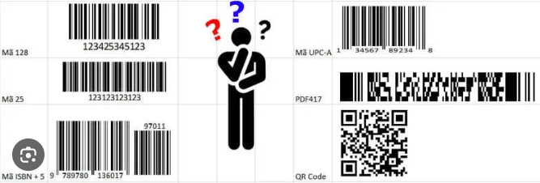
Analysis Main Cause (1)
8/18
Borrow & Return Equipment process
Borrow
Borrow
Return
Return
IT
Record papers
User
Analysis process
User borrow & Return equipment
❶
Main cause
A lot of manual Job, waste papers
No barcode to identify equipment
No software to manage
IT member record information by paper
Next
❷
IT member check manual inventory
❸
Make report monthly
❹

Slide 10


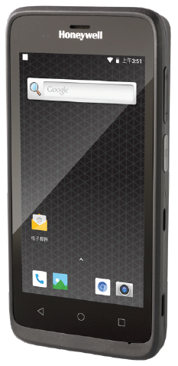
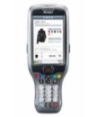

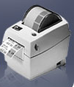
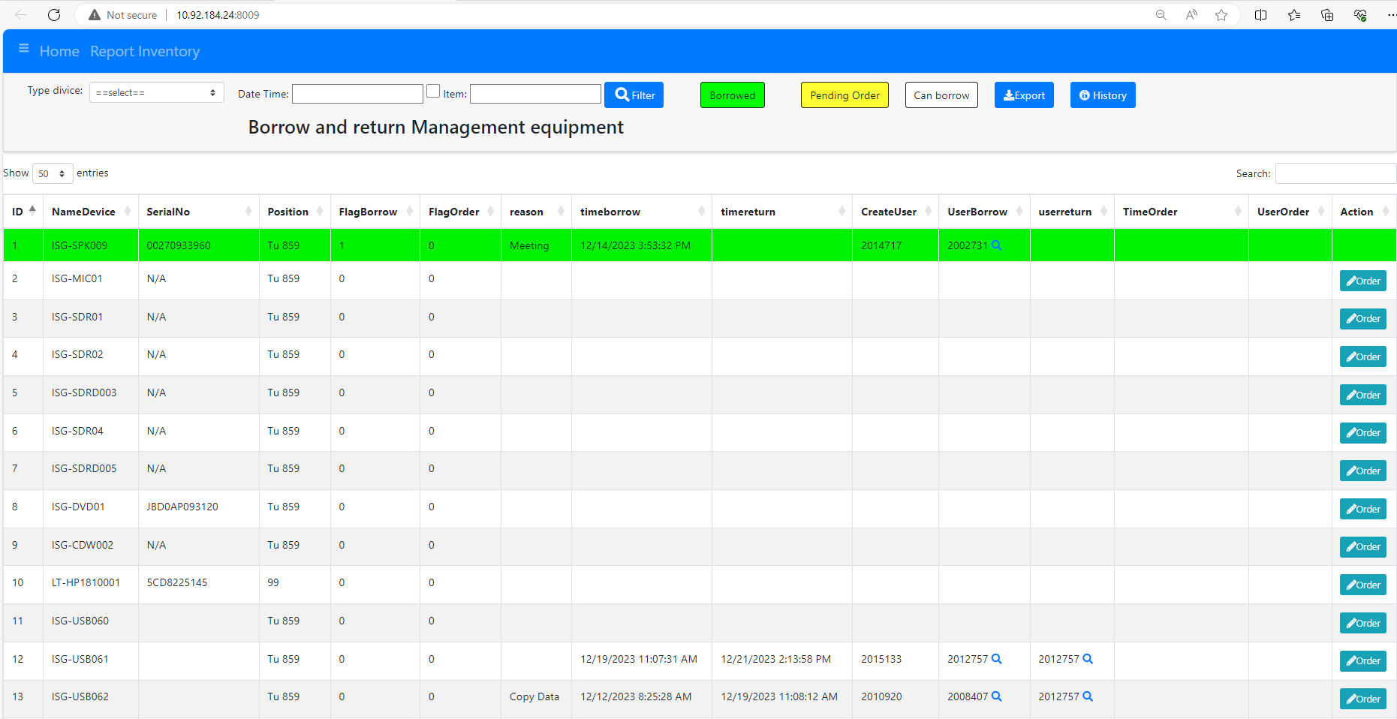

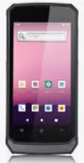


Action 1: Apply Barcode For Function Borrow & Return
9/18
Discuss, Q&A, find solution
List Job
Document, operators,
reports
System Solutions
Database server
Study
Operating
system ?
Part No :
A
Part card:
A
IT
QTY:
30
Discuss
Explain
new operations
PIC, Leader
Issue barcode
Scan barcode
Borrow & Return equipment by scan barcode
Result
Reduce manual job
Save time inventory
Reduce paper
Easy trace history
Auto make report
Visualize on website
IT
User
Borrow & return

Slide 11



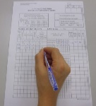
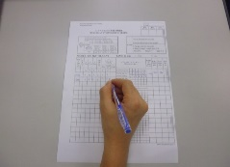

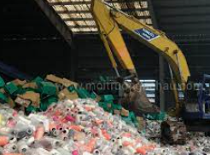

Analysis Main Cause (2)
10/18
Suppliers
Dispatch
Advice
Check manual
Good
receive
➢ A lot of manual job
➢ Always use paper & excel file
➢ Take a lot of time to manage, check inventory, report
➢ Easy mistake
➢ Difficult to trace history operation
Excel file
storing
Transfer,
inventory
Collect information of PC
IT member
To record by Paper, excel
IT member
User department
Maintenance
Supplier
To record by Paper, excel
How to
Improve ?
IT member
Scrap
Scrap area
IT member
To record by excel file
Stationery
warehouse
Request input equipment from GA (Excel file)
Import
export
IT member
User

Slide 12
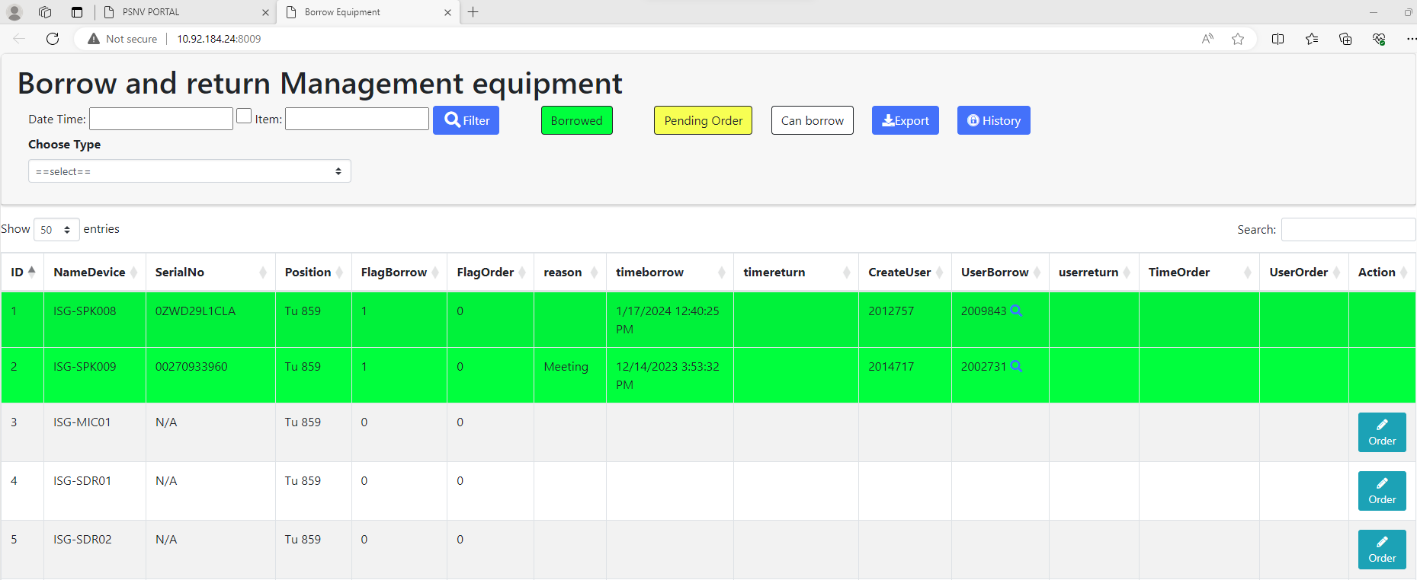
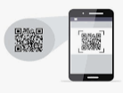



Action 2: Standardize All Manual Jobs
11/18
Step 2
Step4
Select function
Select Device type
Select Location
Read barcode of Serial.
Read user ID card.
Auto report transfer and inventory data
Visualize on website
Offline
Save data to HT
Step1
SQL Server
(ALCMS)
Upload master,
Issue barcode,
Print barcode label.
Step3
Upload data to SQL
Online
Save data to SQL Server
Location(Floor, Area, Table), Device type, Maker
Location, Device type, Serial No, Inventory Date, User ID
Step5
IT
Stationery warehouse

Slide 13

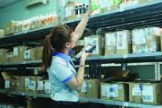
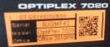


Action 2: Apply Barcode For Asset Management System
12/18
Suppliers
Dispatch
Advice
Check manual
Database
Server
Good
receive
Result
G/R , Transfer,
Inventory
storing
Issue barcode
Transfer,
inventory
User ID
Result
+
IT member
Update or fix new location
User department
Maintenance, Scrap
Maintenance
Result
+
Supplier
IT member
Stationery
Scrap
Scrap area
Result
IT member
Visualization &
Auto report
Stationery
warehouse
Request import equipment from GA (Excel file)
Import
export
Result
IT member
User

Slide 14


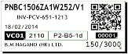
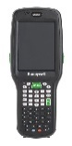



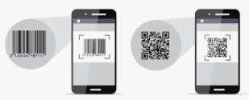



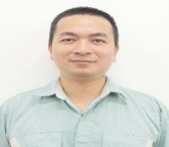

Analysis Main Cause (3)
13/18
Software On WinCE
END OF LIFE 2023
Development Software is quite slow
OS is not update in the future
Not responsive to big data system
The stable of the device is poor, often repaired
Select new device?
Mobile device
Optimize all process?
Standardize the asset management process of IT
Develop software?
Confirming new language & new OS

Slide 15
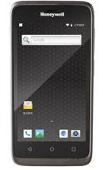



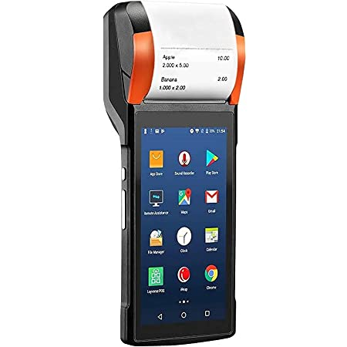
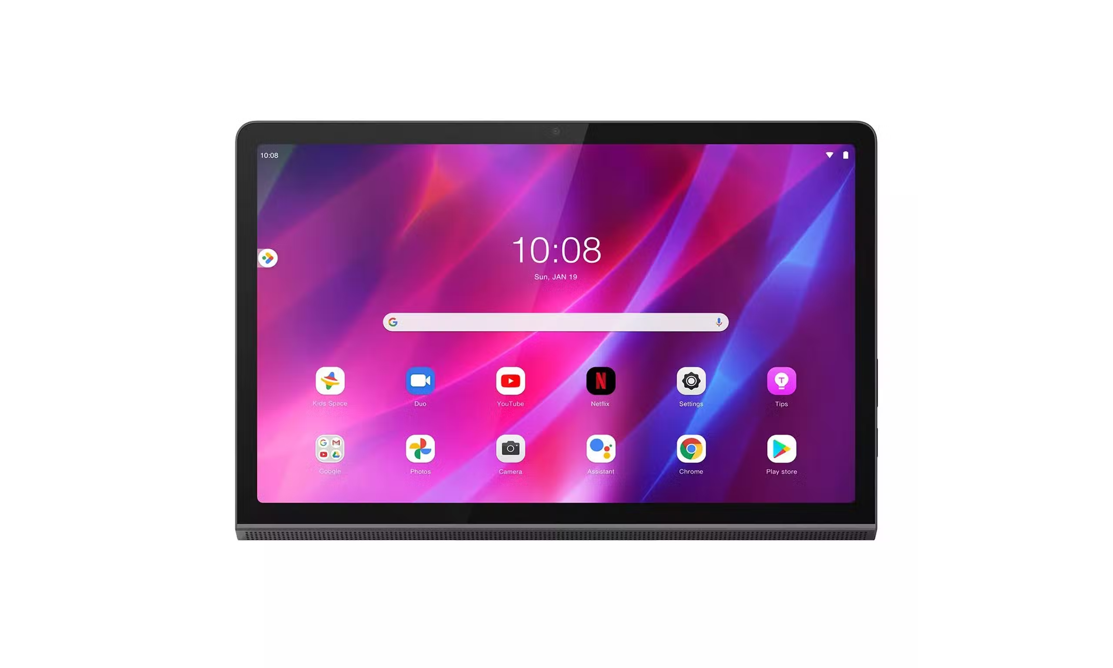
Action 3 : Develop Software On Android OS
14/18
QCC Meeting
analysis
ideas
Target
Select new device
Before
After
Save time check inventory
Old HT device
Mobile device
Reduce manual job
Visualize operations
Make new software
Auto make report
Select New Language & New OS
Android OS is quite commonly and integrates many scanning devices.
Flutter develop applications for mobile devices runs on both Android and IOS.
Large memory, develop faster application.
More faster, stable, beautiful interface.
Easily testing, fix bugs faster.
Develop New Software

Slide 16
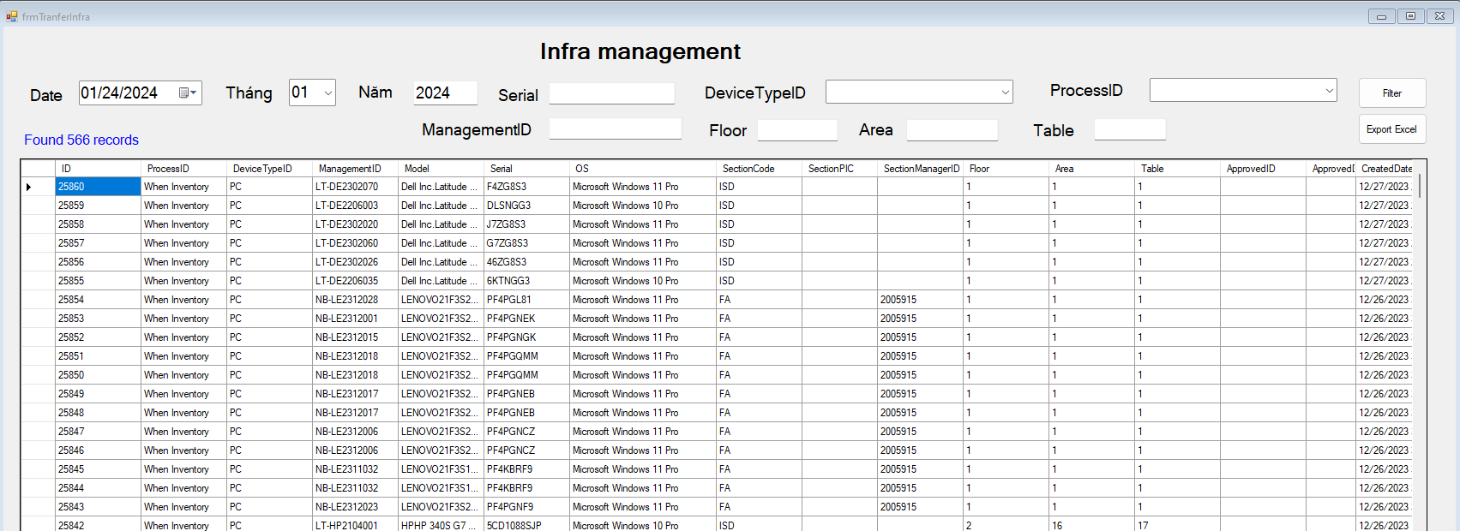
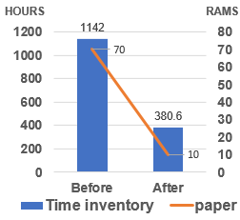
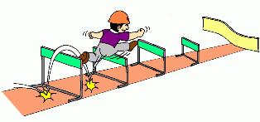
Effect Confirmation
15/18
VISIBLE EFFECT
INVISIBLE EFFECT
software
Visualize
BEFORE QCC
Auto Report
2.8
AFTER QCC
Database
3.8
Result
NEGATIVE AND SOLUTION
1
Negative
Members do not understand each other.
Solution
Analyze deeply problem, clear all process.
QCC
Future
Forward
2
Negative
Difficulty dividing work.
Solution
Based on each person's strengths to divide.

Slide 17


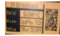
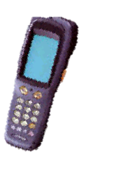





Standardization
16/18
Standardize The Asset Management System
Training Software For IT Member
G/R
Transfer
Inventory
Maintenance
Issue Barcode
SQL Server
(ALCMS)
Scrap
Import stationery
Export stationery
Report
Standardization all manual operations IT department
Manual check
IT
User
Monthly inventory PC
Monthly transfer equipment
IT
Borrow & return
Stationery warehouse

Slide 18
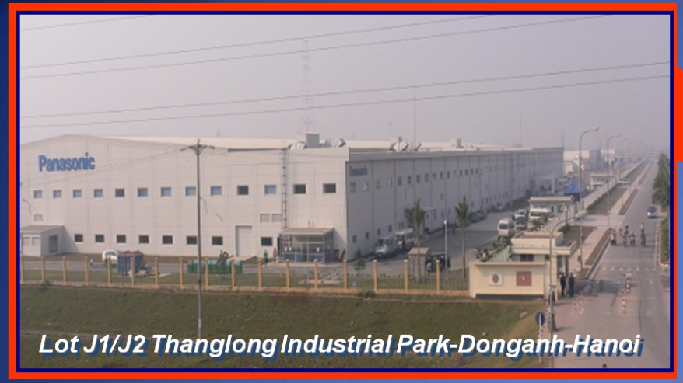

Future Plan
17/18
PSNV IT Systems
PSCS
Procurement
FED
FED
Production
PMD
QCD
ACD
GAS
Expand Asset Life Cycle Management System to All Department
Other factories
Theme for future project
Expand Asset cycle Management System For All Factories

Slide 19




FY2024 SLOGAN
18/18
Thank you so much!
TEAM
ISD Slogan
Change mindset!
Notes:
Thùy : Cảm ơn ban giám khảo, cảm ơn các bạn đã lắng nghe.

